Slide 1

Let’s start with Allah Yaar
Bs in Computer Science

Slide 2
Advantages of Using Computer-Controlled Systems
Accuracy and Precision
Detailed Explanation:
Computer-controlled systems are programmed to perform tasks to exact specifications, eliminating variations caused by human error.
They excel in tasks requiring high precision, such as micro-level assembly, accurate timing, and measurement.
Accuracy improves the quality of products or services and reduces waste.

Slide 3
Advantages of Using Computer-Controlled Systems
Examples:
Robotic arms in semiconductor manufacturing place components with precision to the nanometer scale.
In medical fields, robotic surgeries use systems like the Da Vinci Surgical System to perform operations with high accuracy.

Slide 4
Advantages of Using Computer-Controlled Systems
Speed and Efficiency
Detailed Explanation:
These systems operate at higher speeds compared to humans because they are not hindered by biological limitations like fatigue or need for rest.
Automation enables faster processing of repetitive tasks, improving productivity.

Slide 5
Advantages of Using Computer-Controlled Systems
Examples:
Automated assembly lines in car manufacturing can produce thousands of vehicles daily without pauses.
High-frequency trading systems in stock markets analyze and execute trades within milliseconds.

Slide 6
Advantages of Using Computer-Controlled Systems
Cost-Effectiveness
Detailed Explanation:
Although initial costs are high, long-term savings are realized as there is no need to pay salaries, benefits, or training costs associated with human workers.
Maintenance costs are generally predictable, unlike fluctuating costs of human resources.

Slide 7
Advantages of Using Computer-Controlled Systems
Examples:
Self-checkout systems in retail save costs by reducing the need for human cashiers.
Automated customer service bots reduce the need for large call center staff.

Slide 8
Advantages of Using Computer-Controlled Systems
24/7 Availability
Detailed Explanation:
Unlike humans, machines don’t need breaks, vacations, or sleep, allowing them to operate continuously.
This feature is especially valuable in industries like healthcare, manufacturing, and customer service.

Slide 9
Advantages of Using Computer-Controlled Systems
Examples:
24-hour ATMs provide banking services around the clock.
Factories use computer-controlled machinery to run continuous production cycles, ensuring maximum output.

Slide 10
Advantages of Using Computer-Controlled Systems
Reduced Human Error
Detailed Explanation:
Computers operate based on programmed instructions, ensuring consistent execution of tasks without emotional, physical, or cognitive distractions.
This reduces defects and improves reliability.

Slide 11
Advantages of Using Computer-Controlled Systems
Examples:
Automated checklists in aircraft ensure all pre-flight procedures are completed without missing a step.
GPS navigation systems provide precise directions without the risk of human misjudgment.

Slide 12
Advantages of Using Computer-Controlled Systems
Safety in Hazardous Environments
Detailed Explanation:
Computer-controlled systems can be designed to handle dangerous or inaccessible environments where human intervention is risky or impossible.
They reduce the chances of accidents and health risks for human workers.

Slide 13
Advantages of Using Computer-Controlled Systems
Examples:
Robots in mining extract minerals in hazardous underground conditions.
Autonomous underwater vehicles explore deep-sea regions where humans cannot survive.

Slide 14
Disadvantages of Using Computer-Controlled Systems
High Initial Costs
Detailed Explanation:
Developing, purchasing, and installing these systems require significant upfront investment.
The complexity of customization adds to the cost.

Slide 15
Disadvantages of Using Computer-Controlled Systems
Examples:
A fully automated warehouse system, like Amazon’s, involves advanced robotics, sensors, and AI integration, costing millions.
Hospitals installing robotic surgery systems face costs upwards of $2 million per system.

Slide 16
Disadvantages of Using Computer-Controlled Systems
Lack of Flexibility
Detailed Explanation:
These systems follow predefined instructions and are not capable of improvising or handling unexpected situations effectively.
Human intervention is often needed to reprogram or guide systems in new situations.

Slide 17
Disadvantages of Using Computer-Controlled Systems
Examples:
An automated customer service chatbot struggles to answer nuanced questions that fall outside its programmed responses.
A robotic vacuum cleaner may fail to clean a room if it encounters an obstruction not accounted for in its algorithm.

Slide 18
Disadvantages of Using Computer-Controlled Systems
Job Displacement
Detailed Explanation:
Automation replaces human roles, leading to unemployment and social disruption, particularly in industries reliant on repetitive labor.
Affected workers often need retraining to find employment in different fields.

Slide 19
Disadvantages of Using Computer-Controlled Systems
Examples:
The introduction of autonomous vehicles may reduce demand for drivers in the transportation sector.
Automated manufacturing processes in garment factories have displaced large numbers of low-skilled workers.

Slide 20
Disadvantages of Using Computer-Controlled Systems
Dependence on Technology
Detailed Explanation:
Excessive reliance on automated systems increases vulnerability to failures, cyberattacks, and technical issues.
Any malfunction can lead to downtime, delays, or security breaches.

Slide 21
Disadvantages of Using Computer-Controlled Systems
Examples:
A software bug in a banking system may disrupt millions of transactions.
Cyberattacks on power grids or smart cities can paralyze entire regions.

Slide 22
Disadvantages of Using Computer-Controlled Systems
Maintenance Requirements
Detailed Explanation:
Computer-controlled systems need regular maintenance, including hardware repairs, software updates, and troubleshooting.
Maintenance costs can accumulate over time and require skilled technicians.

Slide 23
Disadvantages of Using Computer-Controlled Systems
Examples:
Periodic servicing of autonomous vehicles is essential to ensure safe operations.
Industrial robots need recalibration to maintain accuracy.

Slide 24
Disadvantages of Using Computer-Controlled Systems
Ethical and Social Issues
Detailed Explanation:
The increased use of automation raises concerns about surveillance, data privacy, and ethical use.
There are debates about fairness and accountability, especially in areas like AI and automated decision-making.

Slide 25
Disadvantages of Using Computer-Controlled Systems
Examples:
Facial recognition systems in public spaces raise privacy concerns.
Automated grading systems in education may unintentionally disadvantage students due to biases in algorithms.

Slide 26
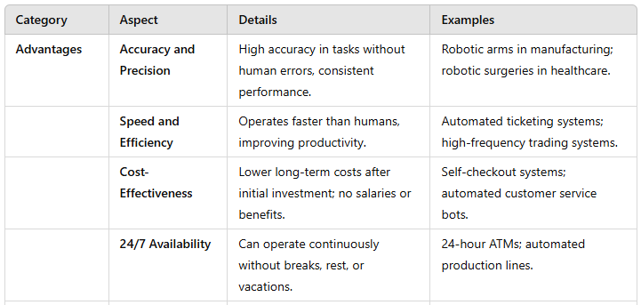
Summary Table

Slide 27
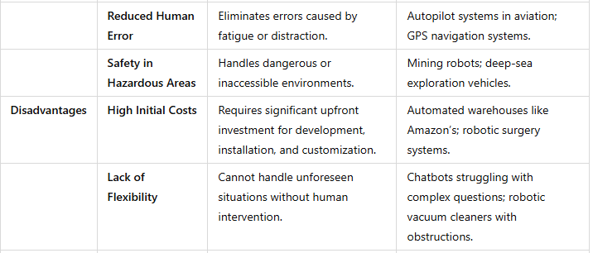
Summary Table

Slide 28
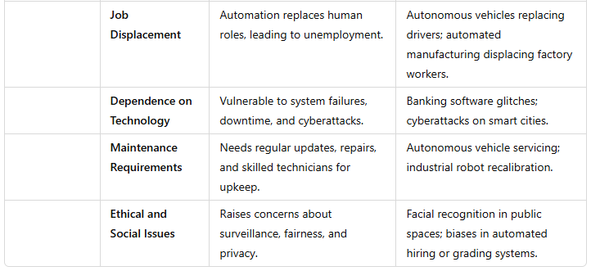
Summary Table

